Slide 1


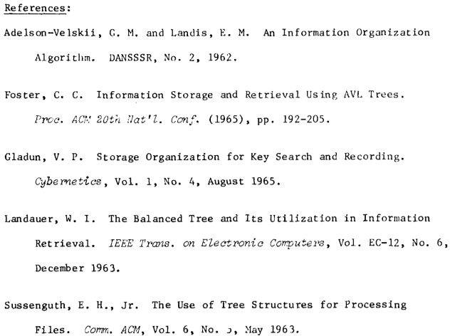
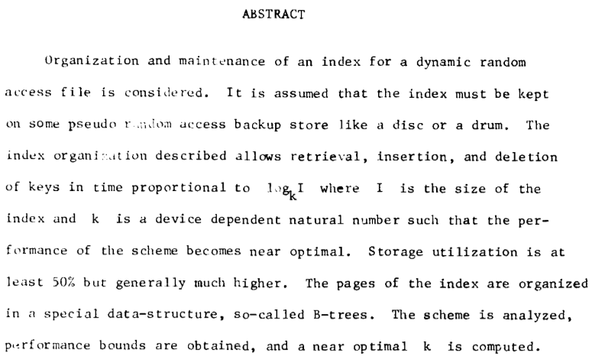
B-trees
Actually in 1970

Slide 2
Large amount of data
Need to store most of the data on disk (or in the cloud)
getting data from these sources is MUCH slower than RAM
Key idea: If we have to go to the disk, make it count!
each disk access fetches a whole block of data (a few KB)
Component | Latency | Adjusted
1 CPU cycle | 0.3 ns | 1 second
L1 cache access | 0.9 ns | 3 seconds
L2 cache access | 2.8 ns | 9 seconds
L3 cache access | 12.9 ns | 43 seconds
RAM access | 120 ns | 6 minutes
SSD access | 50-150 μs | 2-6 days
HDD access | 1-10 ms | 1-12 months
SF to NYC internet | 40 ms | 4 years
Data from 2014

Slide 3
Nodes in a B-tree
In a B-tree of order m, each node has up to m children
The root is either a leaf, or has at least two children
Each internal node except the root has between ⎡m/2⎤ and m children
All leaves are at the same level
tree height is ≈ log_{m} n
m is of the order of 10² or more, so for n ≈ 10⁹, depth is around 5
d₁ | d₂ | … | d_{m−1}
m chosen so that
m − 1 data elements
+ m “pointers” fill a
disk block
< d₁
(d₁, d₂)
> d_{m−1}

Slide 4
Operations on B-trees
Find is a generalization of Find for ordered binary trees
binary search used to find the correct pointer to follow
To insert d, find the leaf node where it should have been
insert into that node (in sorted order)
if the node was full (i.e., it had m − 1 elements), promote the middle element to the parent-level and split this into two half-filled nodes
promote/split may cascade up to the root (tree height will grow)
Delete is similar: remove data, then try to compress with adjacent sibling
d₁ | d₂ | … | d_{m−1}
< d₁
(d₁, d₂)
> d_{m−1}

Slide 5
An optimization: B⁺ trees
Suppose data is made up of (small) keys and (large) values
search done on the basis of keys
Internal nodes only store keys
values are stored only at leaves
Thus, a single disk block can accommodate many more keys
bushier tree ⇒ shallower tree
Insert animation from OpenDSA

